Slide 1
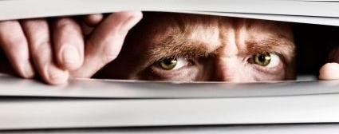
Just looking for your attendance

Slide 2

A safe/supportive learning environment
This text has never been read. “Keyboard Courage” is rampant which may entail some less than ideal topics.
Twitter is a realistic Natural Language Channel
It is a great place to get topics, and messy challenging data.
As a safe learning environment, no offense is intended, merely exposure to a real data set. If offended, please reach out and I will get you additional data sets.
#%@*!!!

Slide 3
Review of Basic Text Visuals
﻿live_A_simple_wordcloud.R
﻿live_B_comparisonCloud_bankLoans.R
﻿live_C_RapSongs.R
Optional:﻿
live_C_RapSongs_censored.R

Slide 4
Let’s make some pyramids

Slide 5

Steps for a pyramid plot…collapse
Combined/Collapsed
into a 2 document corpus
CorpusA – 1000 Tweets
Clean & Collapse
CorpusB – 1000 Tweets
Clean & Collapse

Slide 6
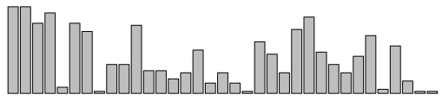
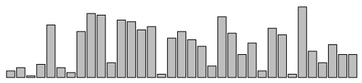
Steps for a pyramid plot…ID common tokens & frequency

Slide 7
Build a “pyramid plot” of frequencies
termA
termB
…
TermN

Slide 8
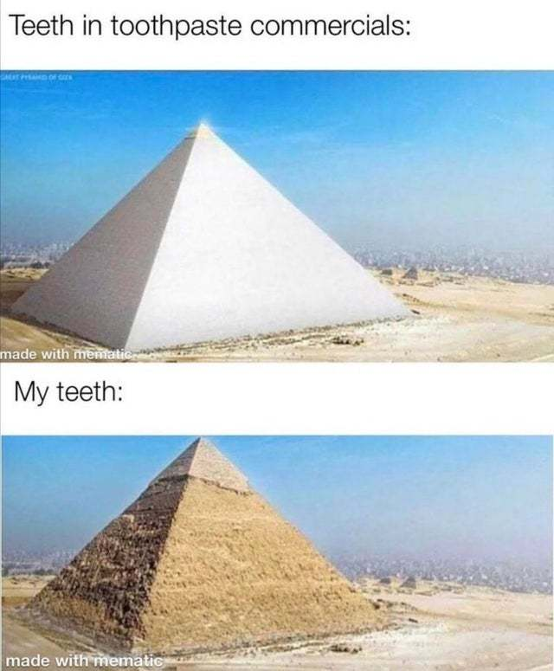
Open ﻿live_D_Pyramid_plots.R

Slide 9
Open ﻿live_E_Retailers_revised.R

Slide 10


Open ﻿live_F_other_wordcloud_libs.R

Slide 11
Lab/Homework
Day2_HW.R

